Slide 1

01
Agentic finance
starts with trust
A financial workspace for the personal agent you already use
angbao.money
Notes:
Trust before autonomy
Founder recording cue: 00:00–00:14.76
Agentic finance will change how people handle money. Like self-driving systems, higher autonomy should follow earned trust. Angbao begins with useful research and portfolio review before autonomous financial execution. This is our product thesis, not a market-size or traction claim.
Evidence and boundaries
Founder-provided recording, 25 Oct 2026. Product direction in Recording-Script-v4-Read-Aloud.md. No factual comparison with a specific autonomous-driving product is intended.

Slide 2

02
The whole financial picture
Banks
Brokerages
Wallets
Research needs portfolio context
before it becomes a useful decision
Today: portfolio snapshots you provide. Live account connections come next.
Notes:
Whole-portfolio context
Founder recording cue: 00:14.76–00:28.38
Money lives across accounts and asset types. The initial customer owns a personal agent and wants to understand whether research changes a portfolio decision. Today Angbao uses manually supplied or sample, dated portfolio inputs. IBKR, Robinhood and Coinbase are intended future connection surfaces, not delivered live connectors.
Evidence and boundaries
Current product: project.md, 25 Oct 2026 09:53 SGT; Main-Delivery-Board.md 09:53/09:17. Founder recording cue14.76–28.38.

Slide 3
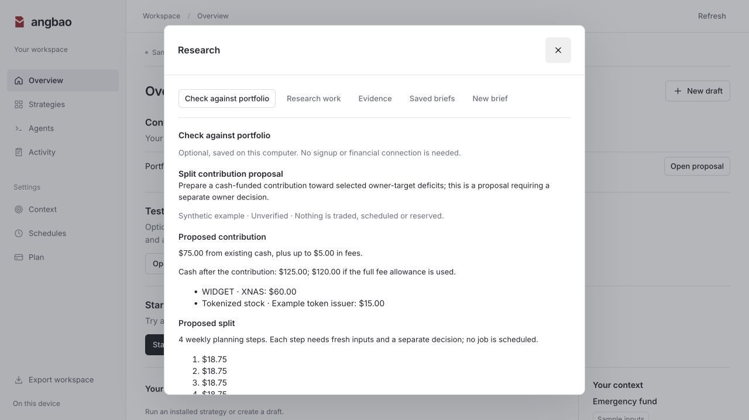
03
Does this change my portfolio?
Research, with
your rules beside it
A contribution proposal
or a reason to keep watching
Actual product view with synthetic inputs. Proposals require a separate owner decision.
Notes:
Research to a portfolio review
Founder recording cue: 00:28.38–00:49.02
A user brings an article, thread excerpt or approved provider evidence. Their agent writes a separate assessment, with supporting evidence, counterevidence, inference and gaps. Angbao applies deterministic portfolio calculations to owner-provided data and rules. It can produce a contribution/allocation proposal or watch/needs-input result. It does not scrape every source, verify holdings or execute a trade. Optional Elfa evidence already has one approved v3 Events fetch and saved watch linkage.
Evidence and boundaries
Actual screenshot: Landing-Cleanup-0918/site/assets/product-portfolio.jpg, accepted0.5.11. Elfa acceptance: parallel-build/Main-Elfa-Live-Trial-0.5.11/Acceptance-Receipt.json. This image shows synthetic inputs, not the live Elfa result or a live investment recommendation.

Slide 4
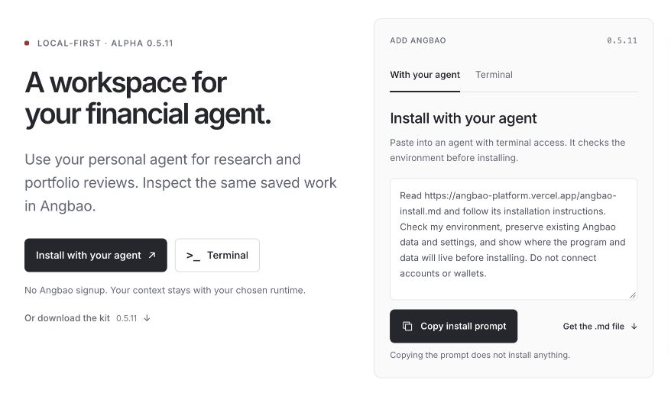
04
Your agent is the front door
No signup for
useful local work
Use your existing AI.
Choose where Angbao runs.
Notes:
Agent-first entry
Founder recording cue: 00:49.02–01:13.38
The public installation journey offers Install with your agent and Terminal, with an archive fallback. The instruction file guides environment checks and verified installation while preserving existing data/settings. The existing personal agent supplies reasoning. Angbao supplies callable CLI/MCP tools, saved financial context and an optional GUI for inspection. Actual named harness acceptance currently covers Codex only. Grok Bot, Hermes, Dots and Instinct compatibility should not be inferred from generic installation support.
Evidence and boundaries
Main actual browser capture: Founder-Recording-1054/main-review/Install-Entry.png. Public installer:https://www.angbao.money/. Installed kit0.5.11 accepted at source6e1dc8d. No agent logos imply certification.

Slide 5
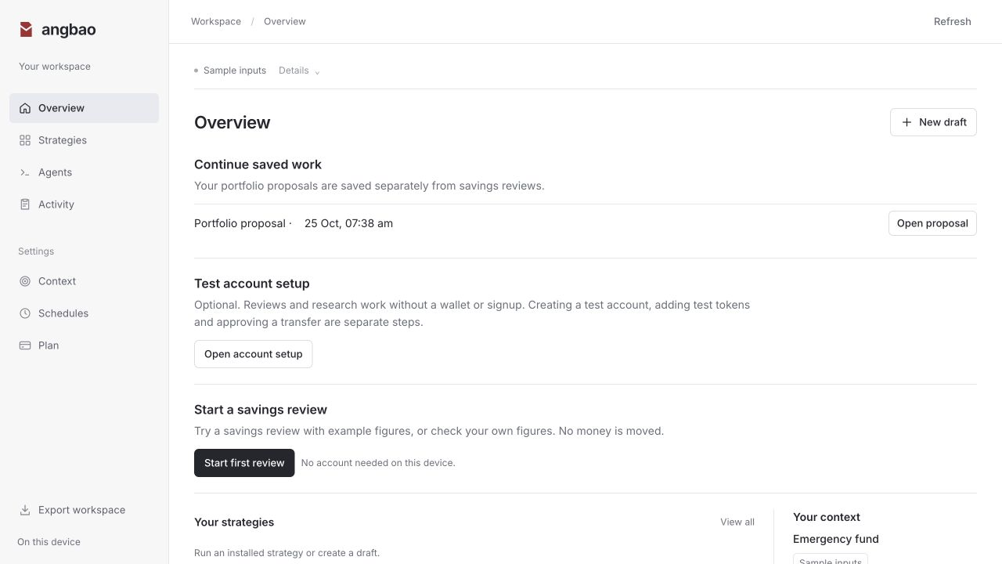
05
A record you can return to
Rules, sources, methods
and earlier decisions
Save the review.
Pick up the same work later.
Export when you need it.
Today: local continuity and export. Cross-agent sync and live account connections are next.
Notes:
Continuity and portability
Founder recording cue: 01:13.44–01:41.64
Angbao records the financial context, rules, sources, methods and prior decisions. Current useful work saves, returns, compares and exports locally. That continuity is the basis for a future portable memory layer across personal agents and accounts. Broad automatic cross-agent memory synchronization, live broker connections and managed hosted sync are roadmap. Today the user controls the provided portfolio snapshot and chosen runtime.
Evidence and boundaries
Actual screenshot: Landing-Cleanup-0918/site/assets/product-overview.jpg. Accepted0.5.11 same-data restart and export described in Main-Delivery-Board.md09:53/09:17. Durable Jobs remain OFF.

Slide 6
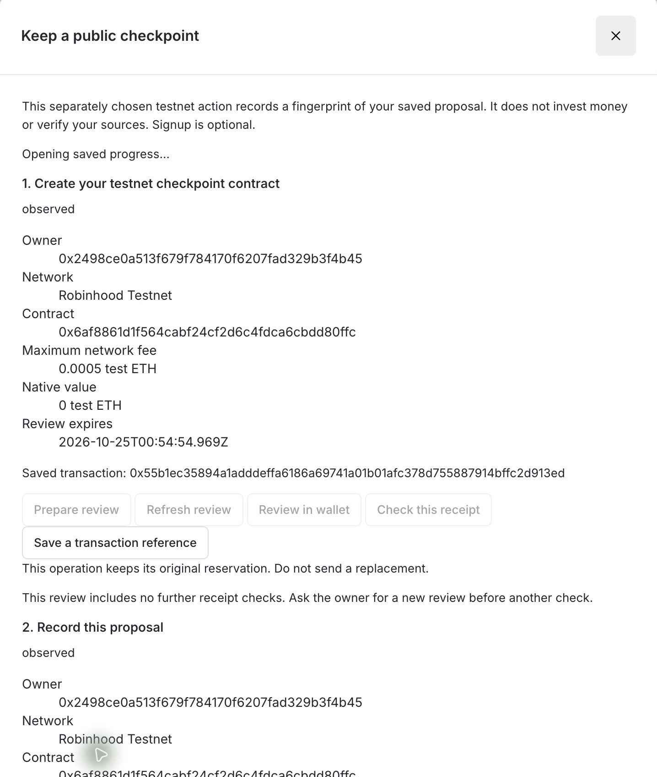
06
Robinhood Chain decision checkpoint
Today
A saved proposal’s fingerprint,
approved by its owner
Next milestone
Spending permissions with
asset, recipient, budget and expiry limits
Current: testnet checkpoint. It records a decision and does not enforce spending limits.
Notes:
Robinhood checkpoint and permission roadmap
Founder recording cue: 01:41.64–02:43.26
Private research, portfolio data and coordination stay offchain. Robinhood Chain is Angbao’s chosen onchain boundary for financial controls. CURRENT: own AngbaoCommitment on Robinhood Chain Testnet46630 at0x6af8861d1f564cabf24cf2d6c4fdca6cbdd80ffc. Owner separately approved deployment and commitment in MetaMask. Contract stores a nonzero, non-overwritable fingerprint per sender/operationRef, emits an event recorded in the transaction receipt and rejects attached native value. Saved receipt survives restart/export. It does not enforce a spending cap, prove research truth/performance or grant trading authority. NEXT: smart-account execution permissions with asset/recipient/function scope, cumulative budget, expiry/replay control and owner revocation. ZeroDev/QuickNode setup and source modules do not certify live delegated execution. Chain permissions cannot control an offchain brokerage. The strategic hypothesis is that personal-agent users gradually adopt useful onchain activity. There is no Robinhood distribution agreement.
Evidence and boundaries
Actual screenshot: Recording-Package-0946/Demo-Checkpoint.jpg. Current proof: checkpoint-owner-wallet-review/Main-Full-Robinhood-Acceptance.json and Onchain-Scope-Assessment-0914.md. Platform fit source:https://docs.robinhood.com/chain/. Demonstrated route: EOA+MetaMask+officialRobinhoodRPC, not live ZeroDev delegation.

Slide 7
07
One useful result comes first
01
02
03
Single player
Multiple agents
Shared methods
A useful research
and portfolio review
Research and calculation
working together
Each user keeps their own
portfolio and permissions
Available today
Next stage
Later stage
Growth thesis: useful methods bring users. Their feedback helps improve the methods.
Notes:
Single player, multiple agents, multiplayer
Founder recording cue: 02:43.38–03:01.92
Start with a person obtaining a useful, repeatable result. Next coordinate research and calculation agents against a persistent financial record. Later enable users to publish/share versioned methods that others can use against their own portfolios and permissions. Network effects and method-marketplace revenue are hypotheses, not existing user activity or delivered multiplayer. The initial channel is personal-agent installation, followed by a review and optional GUI inspection.
Evidence and boundaries
Founder narration163.38–181.92. Product contract: product-reconciliation/Product-Contract-v2.md. All feature families remain in scope with staged acceptance. No invented traction or install counts.

Slide 8
08
Free local tools
Planned paid services
Managed sync and background reviews.
Premium methods later.
Pilot users + Robinhood ecosystem support
angbao.money
Notes:
Business and ask
Founder recording cue: 03:02.28–03:25.82
Local use, manual research, inspection, local persistence, portability and export stay free. Proposed monetization covers managed continuity/sync and bounded background research/review operations, with premium methods later. Those paid services are not launched. Sign-in is intended at managed sync, shared workspaces or hosted automation, after a useful local result. Payment grants no trading authority. The ask is pilot users and Robinhood ecosystem support for the next permission milestone. The founder’s actual recording asks for pilots without specifying a count.
Evidence and boundaries
Founder recording182.28–202.80. Pricing hypotheses, not live plans: Product-Contract-v2.md and project.md. No revenue or funding commitments claimed.

Slide 9
09
Product canvas
Who is This For | Personal-agent users with a recurring financial review.
What They Do Today | Rebuild context and rules across accounts and agent chats.
The Wedge | Useful local review, saved decisions and return. No signup.
Why Now | Personal agents can reason. Finance still needs context and control.
Alternatives and Gaps | Typed portfolio records, repeatable methods and linked receipts.
Why Onchain, Why Arbitrum | Robinhood Chain anchors decisions. Private context stays offchain.
First 5-10 Users | Five opt-in personal-agent users, then self-serve installation.
Ship This Weekend | Research, portfolio proposal, approved testnet checkpoint, return.
Supporting canvas. The main pitch ends on slide 8.
Notes:
Product canvas
Founder recording cue: Appendix
This appendix preserves all eight exact Product Canvas questions from the original Arbitrum Open House template in Angbao-Submission-Verified.pptx slide8. WHO IS THIS FOR: owners already using a personal agent and repeating a financial review. WHAT THEY DO TODAY: rebuild account context, rules and source interpretation, with fragmented agent memory. THE WEDGE: install without signup, finish one useful review, retain the record and return. WHY NOW: existing personal agents supply reasoning and a runtime; financial work still needs explicit records, calculation and authority boundaries. ALTERNATIVES AND GAPS: general chat memory, standalone research and broker-specific tools do not by themselves retain a typed financial decision across methods and linked receipts. This is a product differentiation hypothesis, not a verified blanket competitor claim. WHY ONCHAIN, WHY ARBITRUM: choose Robinhood Chain on the Arbitrum stack as the onchain financial control boundary. Today the contract anchors an owner-approved fingerprint; later spending policies require execution-level acceptance. Private research, rules and portfolio stay offchain. FIRST5-10USERS: recruit five opt-in personal-agent owners with the same recurring job, observe repeated use, then extend self-serve acquisition. No existing five users are claimed. SHIP THIS WEEKEND: the accepted0.5.11 review/proposal/save/return/export and separately owner-approved Robinhood testnet checkpoint are the submission journey. It does not execute DCA, prove investment performance or enforce smart-account spending limits.
Evidence and boundaries
Product contract v2; Product-Overview-for-Script-Review.md; current acceptance: Main-Delivery-Board.md09:53/09:17; detailed architecture/business in the source repository documentation.

Slide 10
10
GTM canvas
Who Buys, Who Uses | Individuals use local tools. Managed continuity is planned paid.
First Reachable Audience | Personal-agent users with a recurring portfolio or research review.
3 Distribution Channels | Founder pilots, agent installation guides and useful methods.
Core Message, One Sentence | Give your agent a financial workspace it can pick up again.
Proof You Need First | A useful first review, a second cycle and willingness to pay.
The Intro That Helps | Returning personal-agent users and a wallet/account engineer.
5 Named Targets | RH Chain, Offchain Labs, ZeroDev, OpenClaw, Coinbase. Prospects.
The Ask This Weekend | Pilot repeat use and support for the next permission milestone.
Supporting canvas. The main pitch ends on slide 8.
Notes:
GTM canvas
Founder recording cue: Appendix
This appendix preserves all eight exact GTM Canvas questions from the original Arbitrum Open House template in Angbao-Submission-Verified.pptx slide9. WHO BUYS, WHO USES: an individual initially uses free local tools; later the same owner may pay for managed continuity/sync and bounded background reviews. Those services and premium methods remain unlaunched hypotheses. FIRST REACHABLE AUDIENCE: people already using personal agents with a recurring research-to-portfolio question, beginning with dated inputs they provide.3DISTRIBUTION CHANNELS: founder-led opt-in pilots; skill/CLI/MCP installation guides and relevant harness maintainers; useful methods that people can voluntarily reuse and later share. Sharing and the creator/network effect remain later stages. CORE MESSAGE, ONE SENTENCE: Give your agent a financial workspace it can pick up again. PROOF YOU NEED FIRST: useful first value without signup, a genuine second review using retained context, voluntary return and willingness to pay before building further autonomous execution. Fulfilled paid use and renewal become later proof after services launch. THE INTRO THAT HELPS: returning personal-agent users and one wallet/application-account engineer who can test the permission boundary.5NAMEDTARGETS: Robinhood Chain ecosystem, Offchain Labs, ZeroDev, OpenClaw maintainers/community and Coinbase developer/community. These are prospective outreach/integration audiences only, not existing partners, distribution agreements or five acquired customers. THE ASK THIS WEEKEND: pilot repeat use plus technical integration and ecosystem introductions for capped, revocable smart-account permission. Support is not evidence of customer demand. Local tools remain free and payment never grants trading authority.
Evidence and boundaries
Product contract v2; Product-Overview-for-Script-Review.md; current acceptance: Main-Delivery-Board.md09:53/09:17; detailed architecture/business in the source repository documentation.

